Slide 1
Putting FAIR Data into Practice
Andrew Antaya - Data Coordinator

Slide 2
Agenda
My Background
Brief Refresher on FAIR Data
Why Make Data FAIR?
Implementing the “F” in FAIR Data
Implementing The “A” in FAIR Data
Implementing The “I” in FAIR Data
Implementing The “R” in FAIR Data
My Advice for Graduate Students
Links to Additional Resources

Slide 3
My Background
M.S. in Natural Resources, emphasis in Wildlife Ecology
B.S. in Fish and Wildlife Biology, minor in GIS
Worked as a Research Specialist (Rangelands) for University of Arizona from 2018-2024
Hired as Data Coordinator for the SDSU Climate Smart Project in July 2024

Slide 4
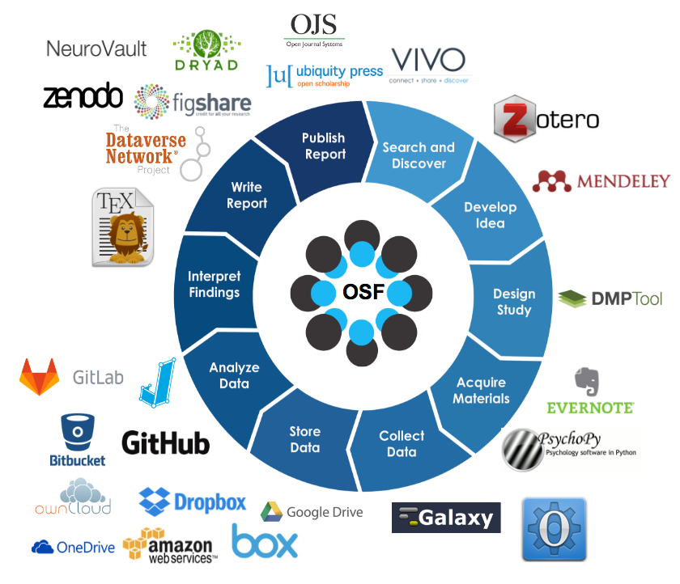
OSF Research Lifecycle
Notes:
This is a diagram of the research lifecycle from the Open Science Framework (OSF). The research lifecycle is a conceptual model that describes the stages of a research project, from planning to publication. I included this diagram to highlight some of the digital tools and where they fit into the research lifecycle. For example, the DMPTool is used during the planning stage to create a data management plan, while Dryad is used during the publication stage to archive data. I will be discussing these tools and others in more detail later in the presentation.

Slide 5
FAIR Data Refresher
Findable
Accessible
Interoperable
Reusable

Slide 6
Key Aspects of FAIR
FAIR is a set of principles, not an implementation
It’s up to you (and your advisor) to make these decisions
There are many options, no one choice is best
Notes:
The important thing about the FAIR principles is that they don’t tell you how to make your data FAIR. Instead, think of the FAIR principles as guidelines, not rules. It’s up to you (and your advisor) to make these decisions. There are many options, and no one choice is best. In this presentation, I will present some options for making your data FAIR, but it will be up to you (and your advisor) to decide which options are best for your project.

Slide 7
Why make data FAIR?
(My) Top Reasons:
Your Future Self Will Thank You
Others Can Reuse and Build Upon Your Work (Which is Good for Your Career)
Required by the Funder
Notes:
My number one reason to work towards making my data FAIR is that it encourages good data management practices, such as documenting your data with rich metadata.
I will describe a common scenario for graduate students. It happened to me and most of my friends in grad school. Your plate is very full attending classes, completing coursework, conducting your research, and writing your thesis or dissertation. You find that you have little time to spend documenting your data. Then you graduate, start a new job, and find that you don’t have any time to adapt your thesis into a journal article. Sometime down the road, you find the time and motivation to publish your work, but you realize that you need to clean up your data or adjust your model, but nothing is documented!. You’ve forgotten the meaning of certain columns, your code is poorly written and doesn’t work. Reaquanting youself with your data and analysis code can be a daunting task. This is where the FAIR principles can help. By making your data FAIR, you are more likely to have rich metadata that will help you understand your data and analysis code in the future. Your future self will thank you.
I have also seen scenarios where a graduate student has left the lab and the advisor wants to continue the work, but they can’t because the data and analysis code are not documented. Believe me when I say that you do not want to be the person that tries to salvage a project with poorly documented data and analysis code.
The second reason to make your data FAIR is that it allows others to reuse and build upon your work. This is especially important for graduate students who are working on a limited timeline. By making your data FAIR, you are more likely to have rich metadata that will help others understand your data and analysis code. This will allow others to reuse your data and analysis code, which can lead to new collaborations and publications. This can benefit your career by increasing your visibility and impact in your field. If you are planning on pursuing a career in academia, citations are important for getting hired and promoted. Making your data FAIR can increase the visibility and impact of your work, which can lead to more citations.
Lastly, making your data FAIR may be required by your funder (at least to some degree). Many funding agencies require that you share your data at the end of the project as a condition of funding. This is especially true for federal funding agencies, such as the National Science Foundation (NSF) and the National Institutes of Health (NIH). Some funders require that you archive data produced under the award in a specific repository, such as the USDA’s AgData Commons. Each funder typically has their own requirements, so be sure to check with your advisor or the funder’s website for specific requirements.

Slide 8
“F” in FAIR Data
Key Questions to Ask to Make Your Data Findable:
Where will we archive the data at the end of the project?
Does the funder have specific requirements for data archiving?
Is there a domain-specific repository that we should use?

Slide 9
Examples of Findable Data
General Purpose Repositories:
Dryad (datadryad.org)
Dataverse (dataverse.org)
Zenodo (zenodo.org)
Figshare (figshare.com)
Notes:
Dryad: A general-purpose repository that makes the data underlying scientific publications discoverable, freely reusable, and citable.
Dataverse: A general-purpose repository that allows researchers to deposit, share, and archive their data. Dataverse is an open-source platform developed by the Institute for Quantitative Social Science at Harvard University.
Zenodo: A general-purpose repository that allows researchers to deposit data, software, and other research outputs. I have used Zenodo to create DOIs for pieces of software that I have developed. One of the cool things about Zenodo is that it integrates with GitHub, so you can create a DOI for a specific release of your software.
Figshare: A general-purpose repository that allows researchers to share their research outputs, including data, figures, and other research outputs.
All of these repositories allow you to create a DOI for your data, which makes it easier for others to cite your data in their publications. DOIs are guarenteed to be stable over time. This can increase the visibility and impact of your work.
You can pick one of these repositories to archive your data, or you can use multiple repositories. It’s up to you (and your advisor) to make these decisions. There are many options, and no one choice is best. I recommend that you discuss your options with your advisor and other members of your lab before you start archiving your data.

Slide 10
Examples of Findable Data
Domain-Specific Repositories:
AgData Commons (agdatacommons.nal.usda.gov)
ICPSR (icpsr.umich.edu)
BioLINCC (biolincc.nhlbi.nih.gov)
Notes:
AgData Commons: A data repository run by the USDA that makes data produced by USDA research available to the public.
For example, for most USDA projects (but apparently not the Climate Smart Project) you are highly encouraged to archive your data in the AgData Commons. The AgData Commons is a domain-specific repository that makes data produced by USDA research available to the public. The AgData Commons is a great place to archive your data if you are working on a USDA project. I’ve archived virtual fence data in the AgData Commons for a project that I worked on at the University of Arizona.
ICPSR: (Inter-university Consortium for Political and Social Research) A data repository run by the University of Michigan that makes data available to the public. ICPSR specializes in social science data, such as surveys and polls.
BioLINCC: A data repository run by the National Heart, Lung, and Blood Institute (NHLBI) that makes data available to the public. BioLINCC specializes in biospecimens and related data, such as blood and tissue samples.
There are many domain-specific repositories that you can use to archive your data. I recommend that you check with your advisor or the funder’s website to see if there is a domain-specific repository that you should use. Some funders require that you archive your data in a specific repository, so be sure to check with your advisor or the funder’s website for specific requirements. NSF and NIH typically require you to archive your data at the end of the project in one of their repositories.
NIH maintains lists of domain-specific repositories that you can use to archive your data. I have included links to these lists in the Additional Resources section at the end of this presentation.

Slide 11
“A” in FAIR Data
Key Questions to Ask to Make Your Data Accessible:
Can my data be accessed through an user interface on a website?
Can my data be access programatically by a machine (through an API)?
Notes:
Putting the “A” in FAIR data is all about making your data accessible to others. There are two main ways that you can make your data accessible: through a user interface on a website and through an API that allows others to access your data programatically.
Accessiblility can be easily accomplished by uploading your data to a repository such as Dryad, Dataverse, Zenodo, or Figshare. These repositories provide a user interface that allows others to download your data.

Slide 12
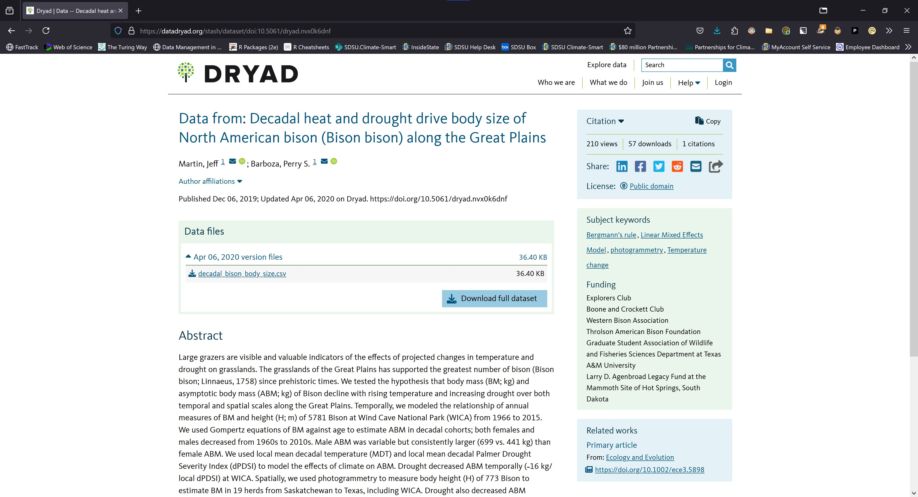
Examples of Accessible Data on a Website
Screenshot of Accessible Dataset on Dryad’s Website
Notes:
Almost all repositories provide a user interface that allows others to download your data. For example, here is an example of a dataset on Dryad. You can see that the dataset is well-documented with rich metadata, such as the title, authors, abstract, keywords, and license.

Slide 13
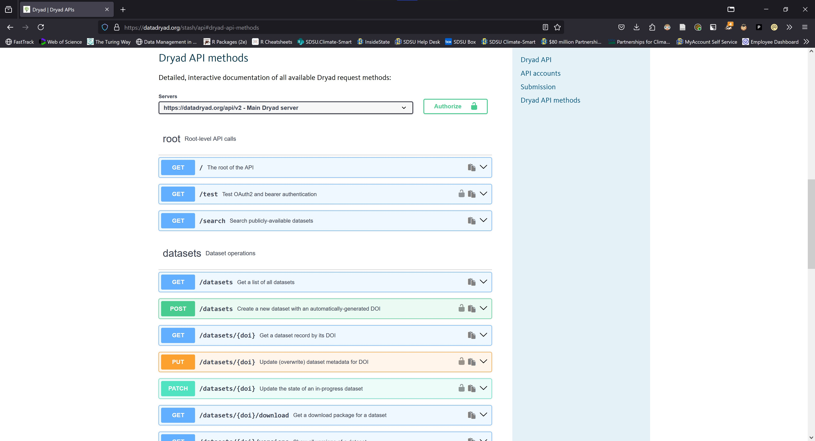
Examples of Accessible Data Programatically
Screenshot of Accessible Data Through Dryad’s API
Notes:
Increasingly, most repositories also provide an API that allows others to access your data programatically. For example, Dryad provides an API that allows others to access the metadata and download datasets from Dryad.
As the amount of publicly available data continues to grow, APIs are becoming more important for accessing data programatically as it allows researchers to automate the process of downloading data. For example, you could write an R script to download all datasets in a repository that match a specific keyword or author for conducting a meta-analysis. This would be much faster than downloading each dataset manually.

Slide 14
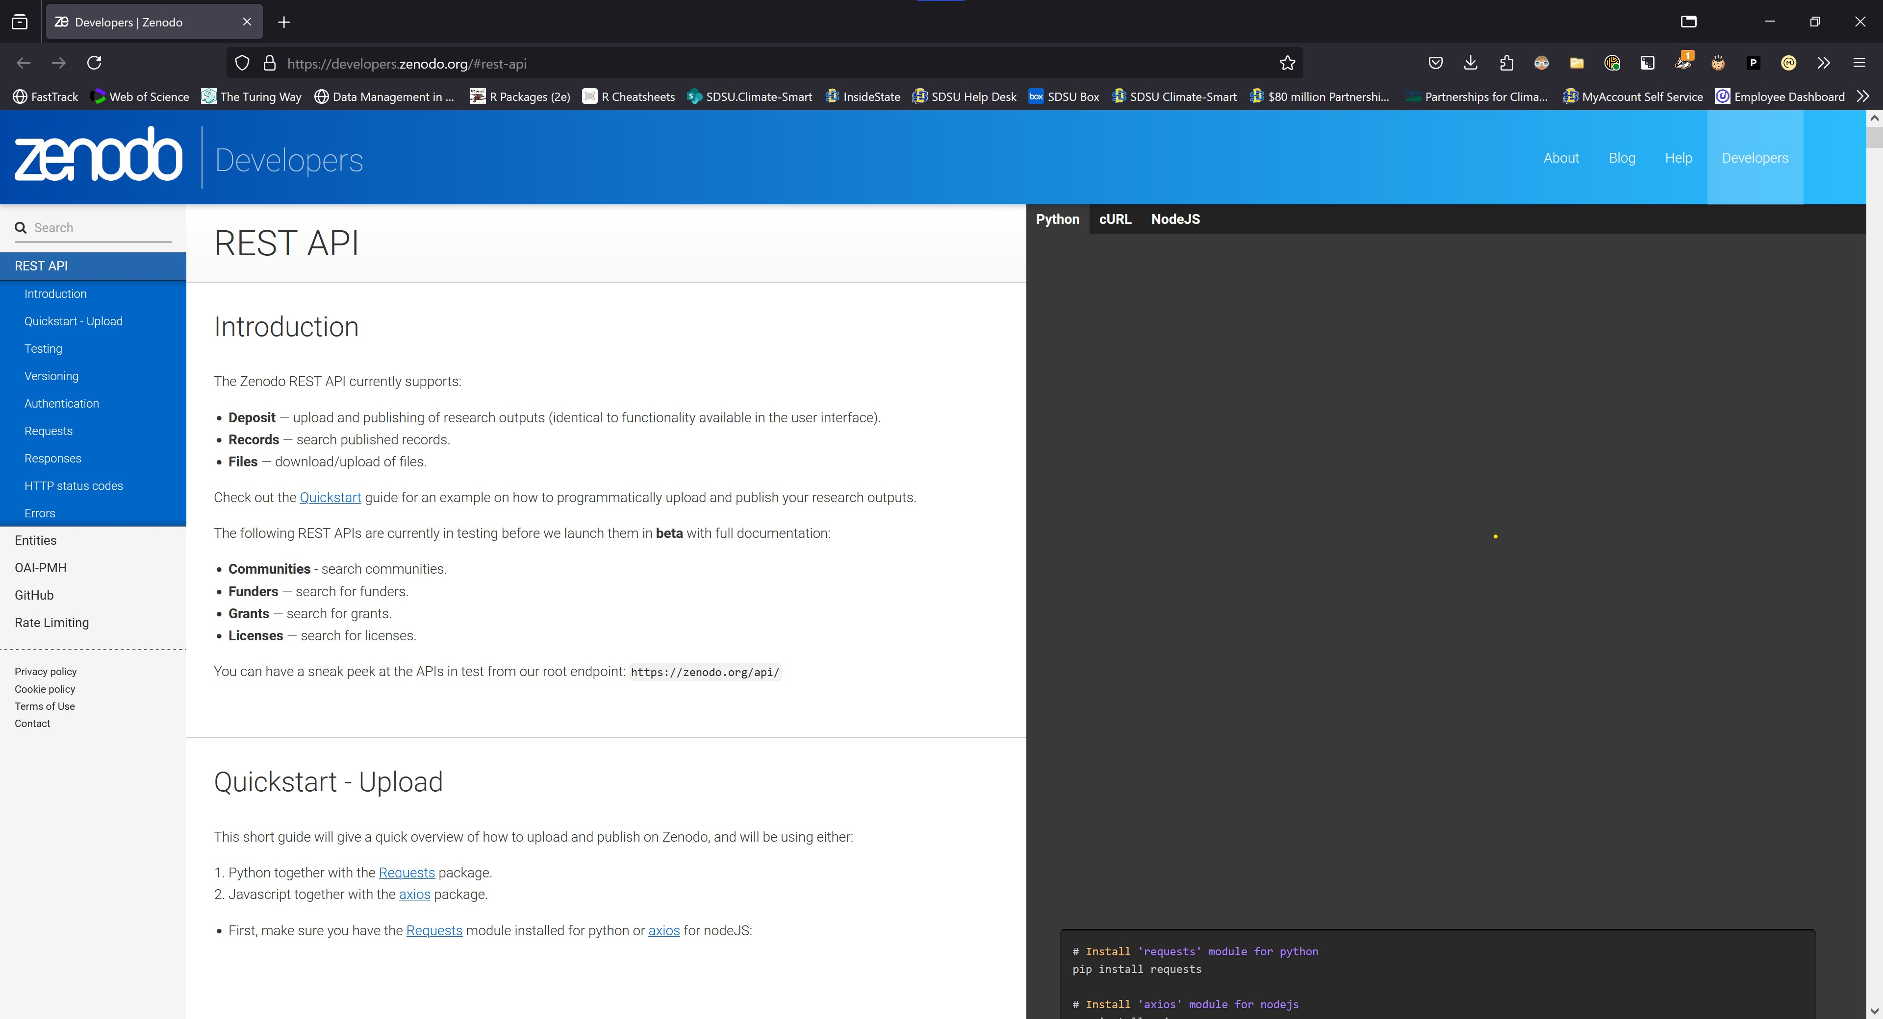
Examples of Accessible Data Programatically
Screenshot of Accessible Data Through Zenodo’s API
Notes:
Most of the general-purpose repositories also have good documentation for their APIs. For example, Zenodo provides a comprehensive API documentation that explains how to access the metadata and download datasets from Zenodo. They also provide code examples in multiple programming languages, such as Python, JavaScript, and cURL (but sadly not R).
I would consider a repository that provides an API to be more accessible than one that does not provide an API. I recommend that you check with the repository to see if they provide an API for accessing your data programatically.

Slide 15
“I” in FAIR Data
Key Questions to Ask to Make Your Data Interoperable:
What format should we use to store the data?
Are any of file formats proprietary?
Are there standards within my field/discipline that we should follow?
Notes:
Putting the “I” in FAIR data is all about making your data interoperable with others. There are three main ways that you can make your data interoperable: by choosing the right format, avoiding proprietary file formats, and following standards within your field or discipline.

Slide 16
Interoperable Data Formats
CSV (Comma-Separated Values)
JSON (JavaScript Object Notation)
XML (eXtensible Markup Language)
Notes:
When choosing what format to archive your data in, I recommend that you choose a format that is widely used and supported by others. For example, CSV (Comma-Separated Values) is a widely used format that is supported by most software programs, such as R, Python, and Excel. JSON (JavaScript Object Notation) and XML (eXtensible Markup Language) are also widely used formats that are supported by many software programs.

Slide 17
Proprietary File Formats
Microsoft Excel (.xls, .xlsx)
STATA
SPSS
Notes:
Examples of proprietary file formats include Microsoft Excel (.xls, .xlsx), STATA, and SPSS. These file formats are proprietary in that they are owned by a specific company and require a software license to access and use the data. Proprietary file formats can make your data less interoperable with others, especially if they require expensive software licenses. Try to avoid archiving your data in a proprietary file format if possible.
Microsoft Excel, while a proprietary file format, is widely used and supported and can be a good choice for archiving your data. However, be aware that Excel has some limitations, such as the number of rows and columns that it can handle. If you are working with a large dataset, you may want to consider archiving your data in a different format, such as CSV. I generally recommend CSV files over Excel files in almost all situations.
Now that’s not to say you can’t use STATA and SPSS file formats during your analysis. STATA and SPSS files have some advatanges over CSV files. However, I recommend that you convert your data to a non-proprietary format before archiving it, for example, by converting your data from a STATA file to a CSV file. This will make your data more interoperable with others.
In other situations, there simply isn’t a way around proprietary file formats. For example, if you are working with a proprietary software program that only outputs data in a proprietary format, you may have no choice but to archive your data in a proprietary format. In this case, I recommend that you provide detailed instructions on how to access and use the data in the README file that accompanies your data.

Slide 18
“R” in FAIR Data
Key Questions to Ask to Make Your Data Reusable:
Is there enough metadata for others to understand and reuse our data?
What metadata standards should we use?
Notes:
Perhaps the most important aspect of FAIR data is making your data reusable by others (including your future self). If your data is not reusable by others, then what’s the point of making it findable, accessible, and interoperable?
There are two main ways that you can make your data reusable: by providing rich metadata and following metadata standards.
Metadata is data about data. It describes the content, quality, condition, and other characteristics of your data. Metadata can include information such as the title, authors, abstract, keywords, license, and provenance of your data. Metadata can be stored in a README file that accompanies your data or it can be stored as comments in your data file. I prefer to store metadata in a README file that accompanies my data, as it keeps the metadata separate from the data and makes it easier to update the metadata without having to update the data.
Adding metadata during your project reduces your “data curation debt”. Data curation debt is the amount of work that you need to do to make your data FAIR at the end of your project. The more metadata you add during your project, the less data curation debt you will have at the end of your project. I recommend that you add metadata as you go along, rather than waiting until the end of your project to add metadata.

Slide 19
Levels of Metadata
Project Level Metadata
Dataset Level Metadata
Variable Level Metadata

Slide 20
Project Level Metadata
Data Management Plan
Data Sources Catalog
Roles and Responsibilities
Research Protocol
Standard Operating Proceedures

Slide 21
Dataset Level Metadata
README
Changelog
Data Cleaning Plan

Slide 22
Variable Level Metadata
Data Dictionary
Codebook

Slide 23
Metadata Standards
Ecological Metadata Language (EML)
Darwin Core
Content Standard for Digital Geospatial Metadata (CSDGM) (FGDC metadata standard)
Notes:
There are many metadata standards that you can use to describe your data. Some metadata standards are general-purpose, such as the Ecological Metadata Language (EML), while others are domain-specific, such as Darwin Core for biodiversity data and the Content Standard for Digital Geospatial Metadata (CSDGM) for geospatial data.
I recommend that you use a metadata standard that is widely used and supported by others in your field. For example, if you are working with biodiversity data, you may want to use Darwin Core to describe your data. If you are working with geospatial data, you may want to use CSDGM to describe your data. Using a widely used metadata standard makes it easier for others to understand and reuse your data.
Additionally, where you choose to archive your data may have specific requirements regarding the metadata standard. Check with the repository to see if they have specific requirements for the metadata standard that you should use.
Be warned, metadata standards have a steep learning curve. I would recommend that you first identify which metadata standard is relevant to your field, and then find a digital tool that can help you create metadata in that standard. For example, I use the ezEML tool to create EML metadata for my data. I have included links to these tools in the Additional Resources section at the end of this presentation.

Slide 24
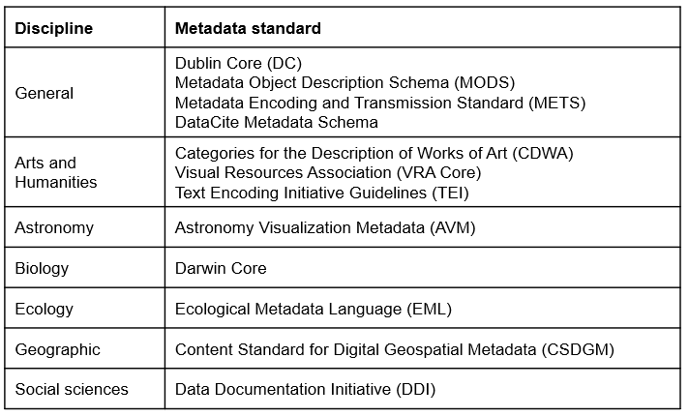
Metadata Standards Table
Metadata Standards Table from Data Management in Large-Scale Education Research

Slide 25
Summary
Key Takeaways:
Add Metadata to Your Data
Choose a repository to archive your data
Check if the repository requires specific metadata standards (e.g., EML)
Check if the funder has specific requirements for data archiving (e.g., AgData Commons)
Archive your data in a widely used and non-proprietary file format (e.g., CSV)

Slide 26
My Advice for Grad Students
Write a Data Management Plan (DMP) - Think Through the Steps to Make Your Data FAIR
Discuss the DMP with your Advisor Sooner Rather Than Later
Don’t Wait Until the End of Your Project to Make Your Data FAIR
Notes:
My advice to you is to write your own data management plan. This will help you think through the steps you need to take to make your data FAIR. It will also help you communicate your plan to your advisor and other members of your lab. You can use the DMPTool to help you write your data management plan. The DMPTool is a free online tool that helps you create data management plans that meet the requirements of specific funding agencies.
I also recommend that you discuss your data management plan with your advisor sooner rather than later. Your advisor may also have specific requirements specified by the funder, such as where the data must be archived, so be sure to check with them before you start or check the funder’s website for more information.
Lastly, I recommend that you don’t wait until the end of your project to make your data FAIR. Start today. It’s much easier to make your data FAIR as you go along, rather than trying to do it all at once at the end of your project. If you wait until the end of your project, you may find that you don’t have the time or motivation to make your data FAIR.

Slide 27
Links to Additional Resources
Data Management in Large-Scale Education Research: https://datamgmtinedresearch.com/
DMPTool - https://dmptool.org/
How Should I Include Dryad in my DMP? https://blog.datadryad.org/2023/07/13/for-researchers-including-dryad-in-your-data-management-plan/
General Repositories - https://www.nlm.nih.gov/NIHbmic/generalist_repositories.html
Specialized Repositories - https://www.nlm.nih.gov/NIHbmic/domain_specific_repositories.html
EML Creation Tool - https://ezeml.edirepository.org/

